Slide 1


Slide 2





Cyber Security
in the age of AI
Protecting Data and Digital Systems
Presented by: Sudhanshu Raj
BTECH CSE 1st year I Section B

Slide 3











What is
Cybersecurity?
Cybersecurity is the practice of protecting computers, smartphones, networks, software, and data from unauthorized access, attacks, theft, or damage.
Data protection
System security
User privacy

Slide 4










Importance of
Cyber Security
Protects sensitive data
Prevents cyber crimes
Reduces financial loss
Builds trust in digital

Slide 5


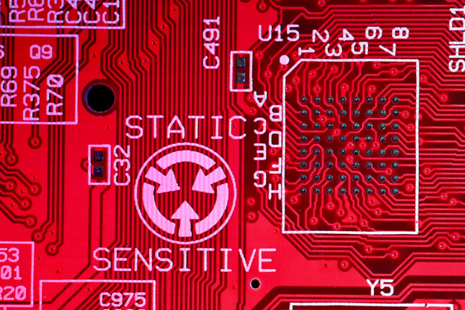


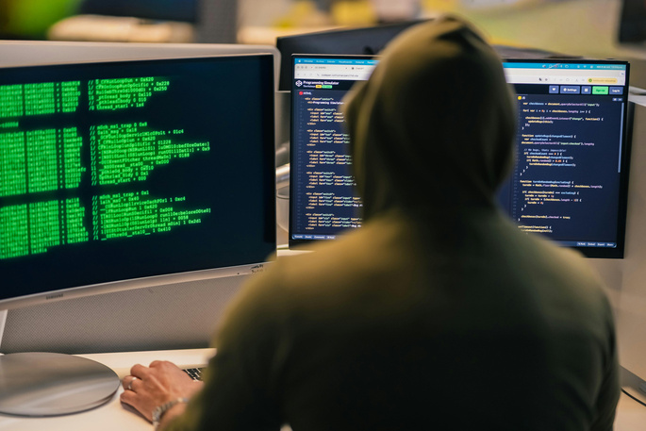

Common
Cyber Threats
Malware
Phishing
Ransomware
Hacking
Malicious software that damages systems or steals data
Fake messages or emails used to steal personal information
Attacks that lock data and demand payment
Unauthorized access to systems or networks

Slide 6
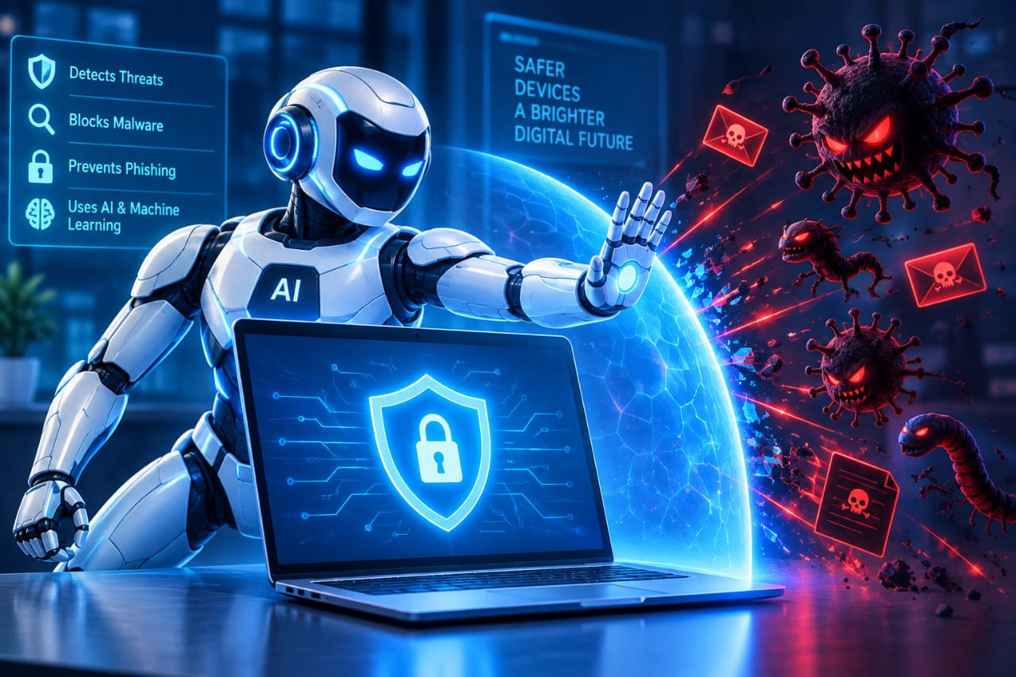



Role of AI in Cybersecurity
The Primary role of AI in Cyber Security
Protect Bank Account
Stop Malware
Detection

Slide 7


Cyber Security
Practices
Use strong passwords
Install antivirus software
Be careful with links
Update systems regularly

Slide 8



Challenges
Hackers also use AI to create more advanced attacks
Privacy issues
Fake Videos [ Deep Fake ]
Human Mistakes

Slide 9



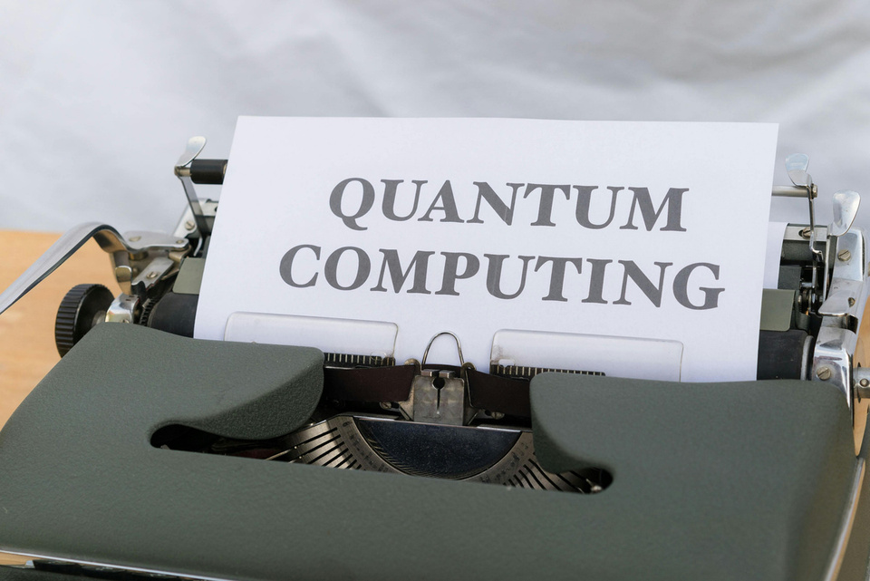





Future of Cyber security
•AI Powered Threat detection
•Zero Trust Security
• Quantum-resistant encryption
•Cyber security job will grow rapidly

Slide 10
Conclusion
Everyone has a role
Prevention is better
Awareness

Slide 11
Thank You
For Your Attention
ff
Under the Guidance of :
Ms. Aastha Kashyap
Assistant Professor, Department of CSE

